Slide 1
Perceptron and Multilayer Perceptron

Slide 3

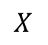


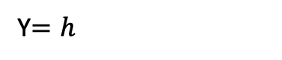

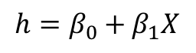

Up to this point we just re-branded logistic regression to look like a neuron.
How about regression?
Affine
Activation
Linear
Loss Fun
$$ℒ(β)=\sum_{i}^{n}{ℒ_{i}\left(β\right)}$$
$$X$$
$$h=β_{0}+β_{1}X$$
Y$=h$
$$X$$
XW
$$I$$
$$Y$$
Where $I$ is the identity function

Slide 4
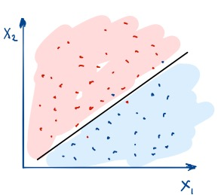
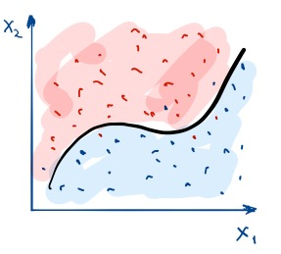
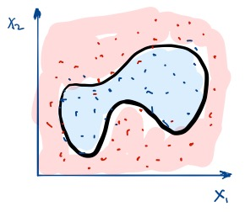
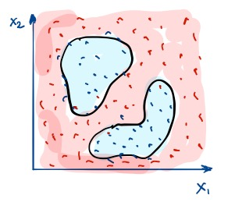
So what’s the big deal about Neural Networks?

Slide 5
So what’s the big deal about Neural Networks?
No Linear Functions!

Slide 6
For regression?
No Linear Functions!

Slide 7
For regression?

Slide 8
Outline
Introduction to Artificial Neural Networks
Review of Classification and Logistic Regression
Single Neuron Network (‘Perceptron’)
Multi-Layer Perceptron (MLP)

Slide 9
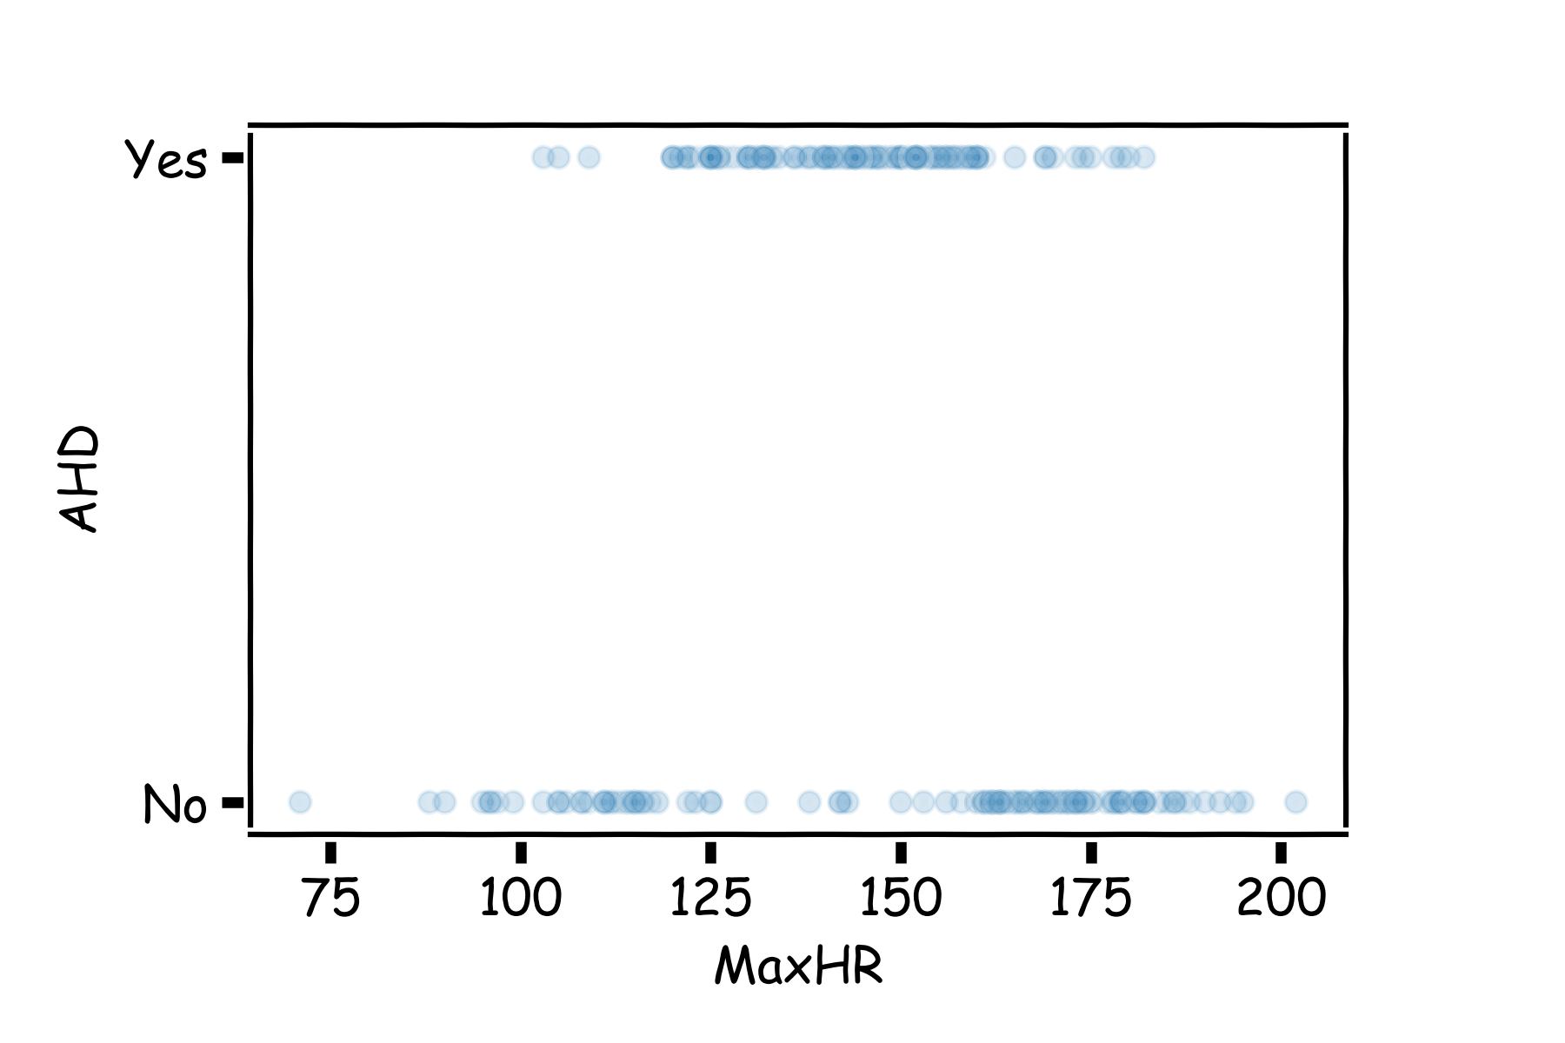
Example Using Heart Data
Slightly modified data to illustrate concepts.

Slide 10
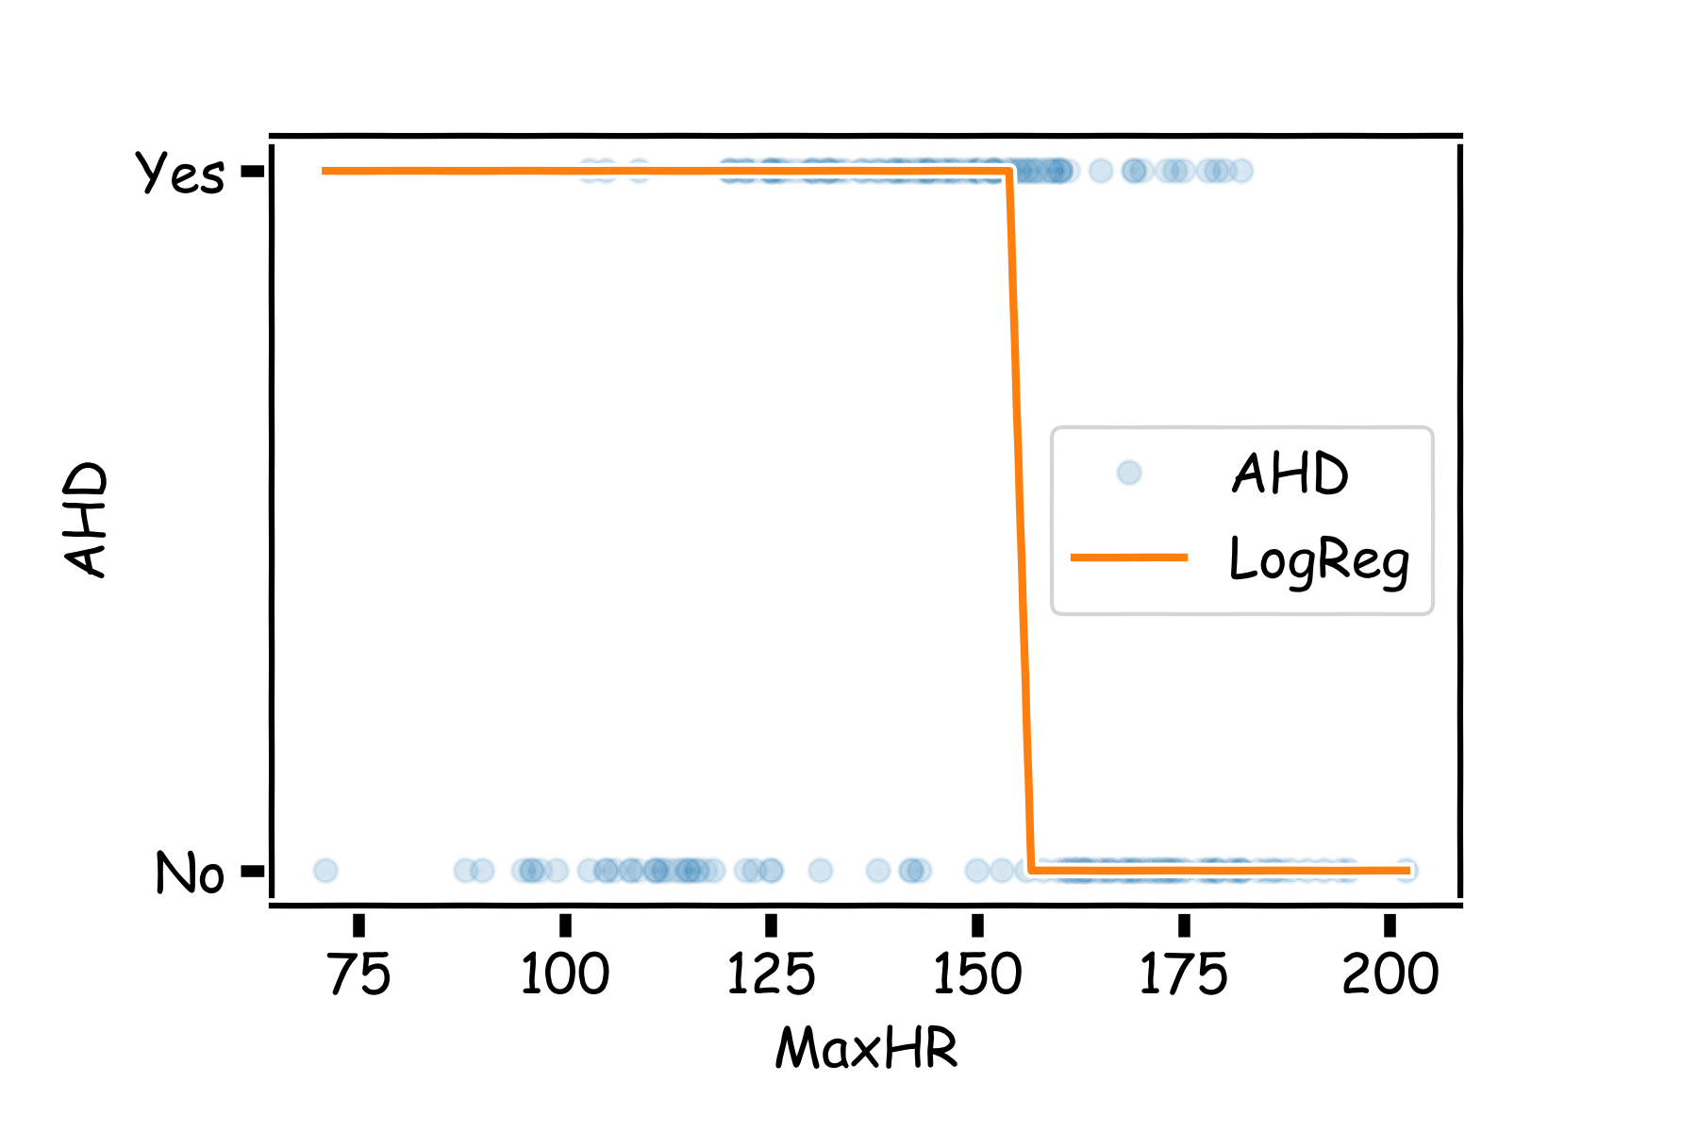

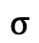
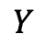

Example Using Heart Data
Choose W such as
$$XW$$
$$σ$$
$$Y$$
$$X$$
Right part of data are fitted well

Slide 11
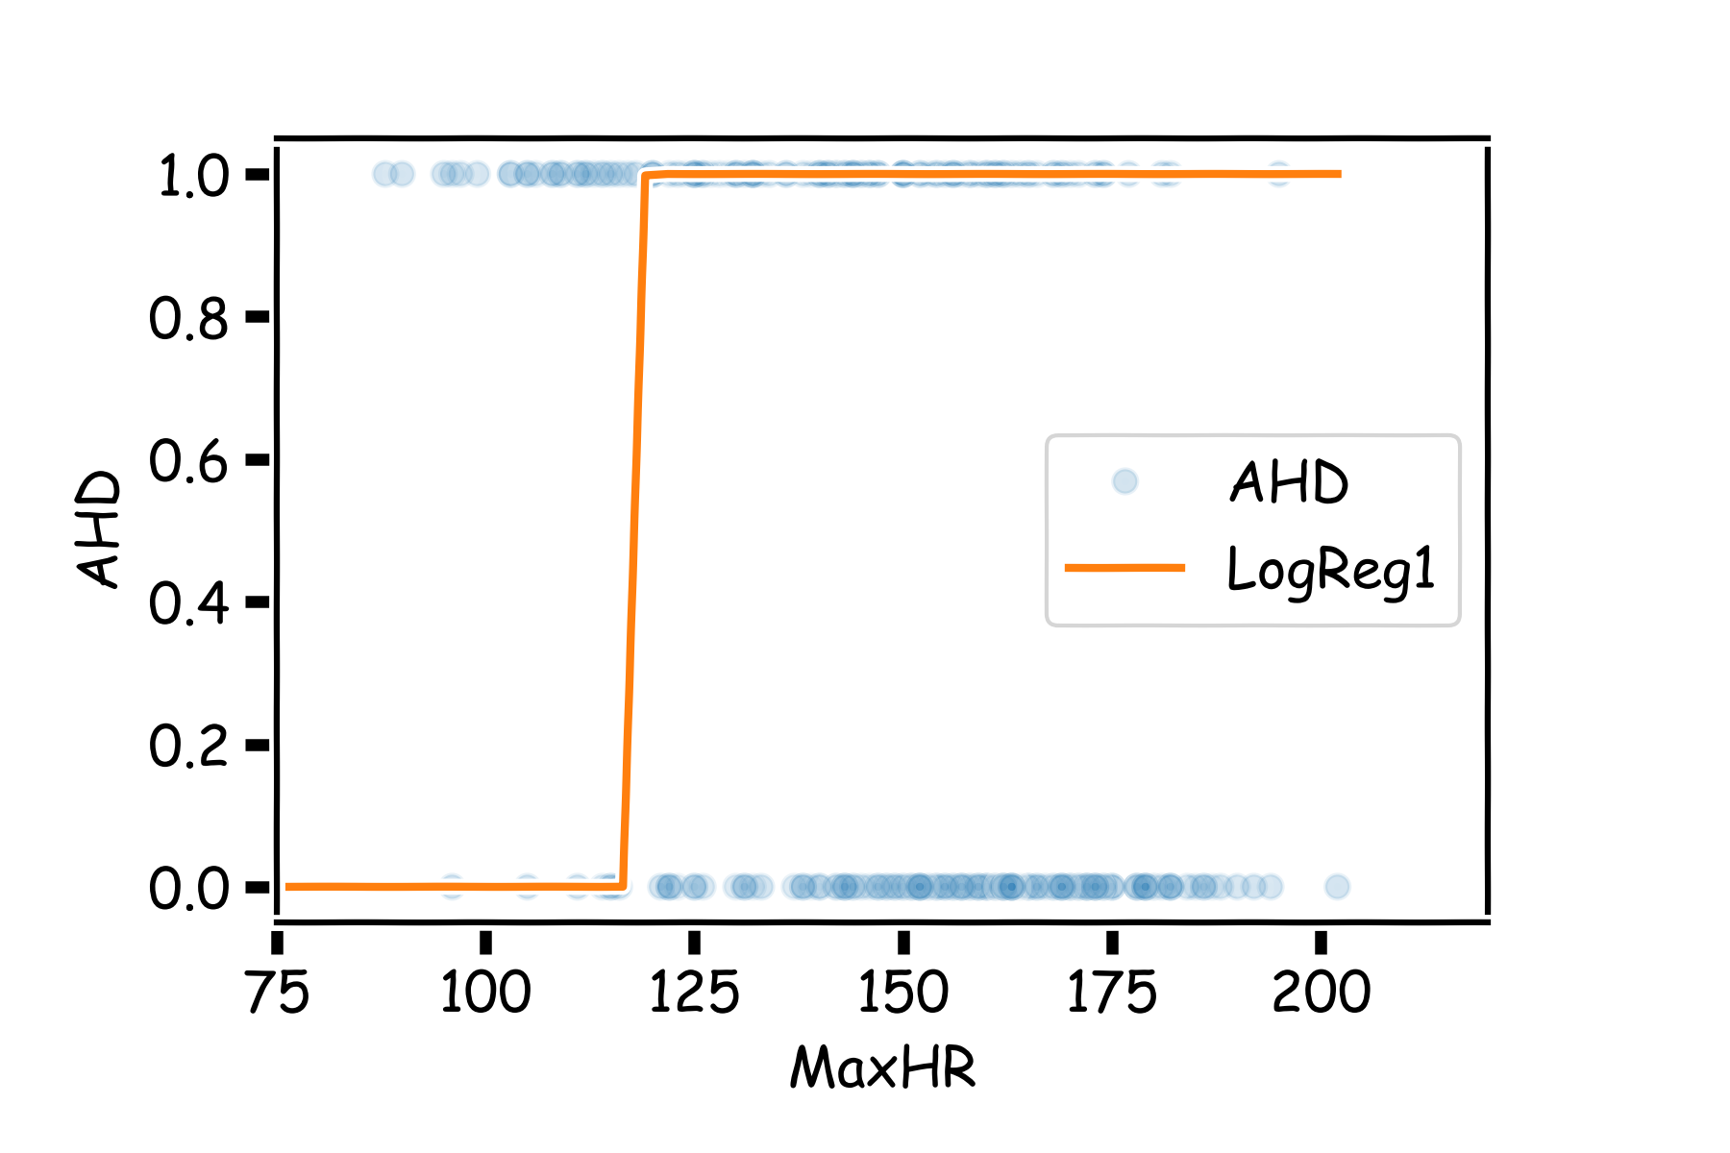

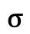
Example Using Heart Data
Choose W such as
$$XW$$
$$σ$$
$$Y$$
$$X$$
Left part of data are fitted well

Slide 12
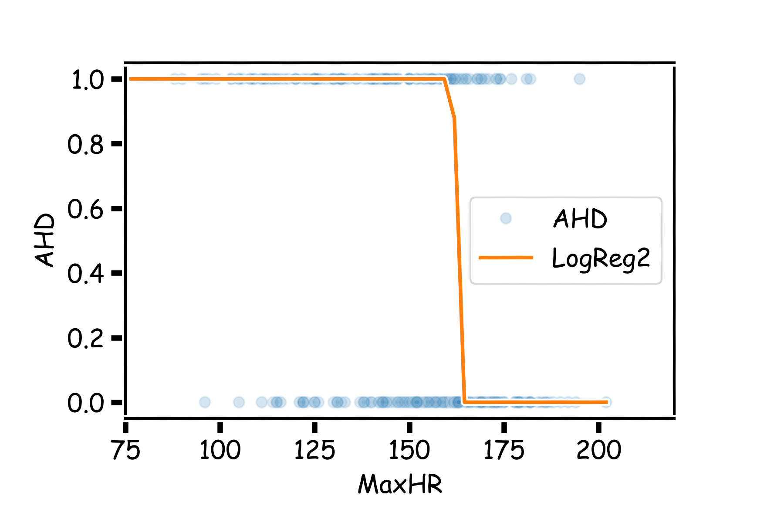




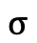
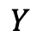
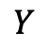
Example Using Heart Data
Two regions, two nodes
$$XW$$
$$σ$$
$$Y$$
$$X$$
$$XW$$
$$σ$$
$$Y$$
$$X$$

Slide 13
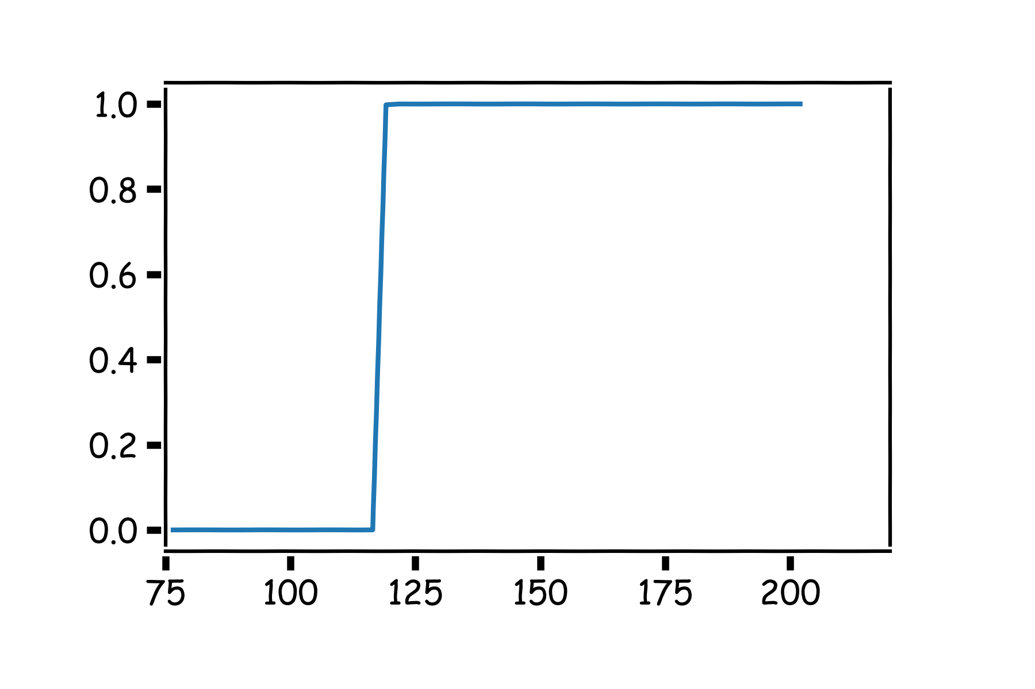
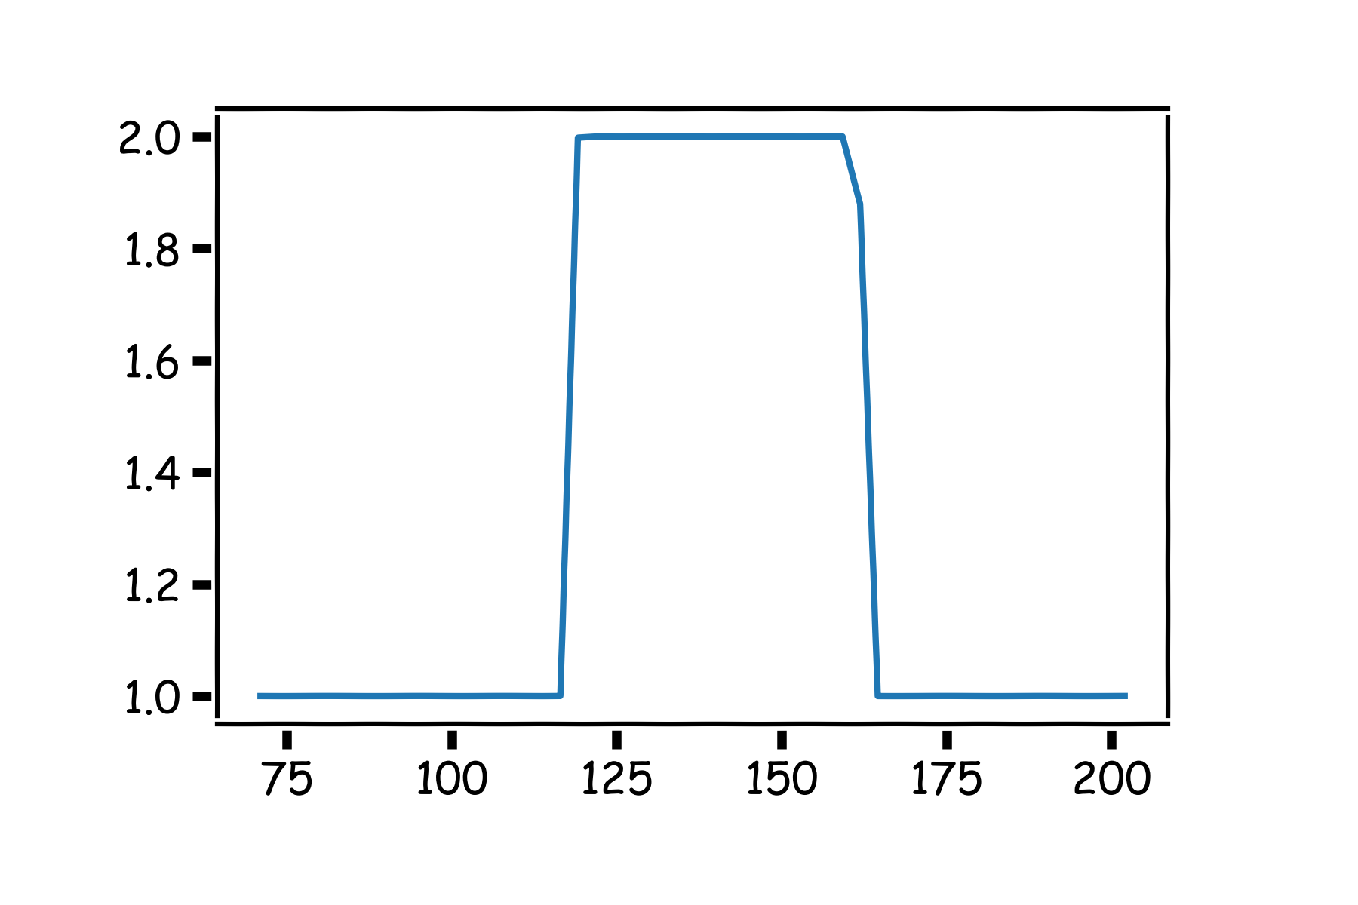
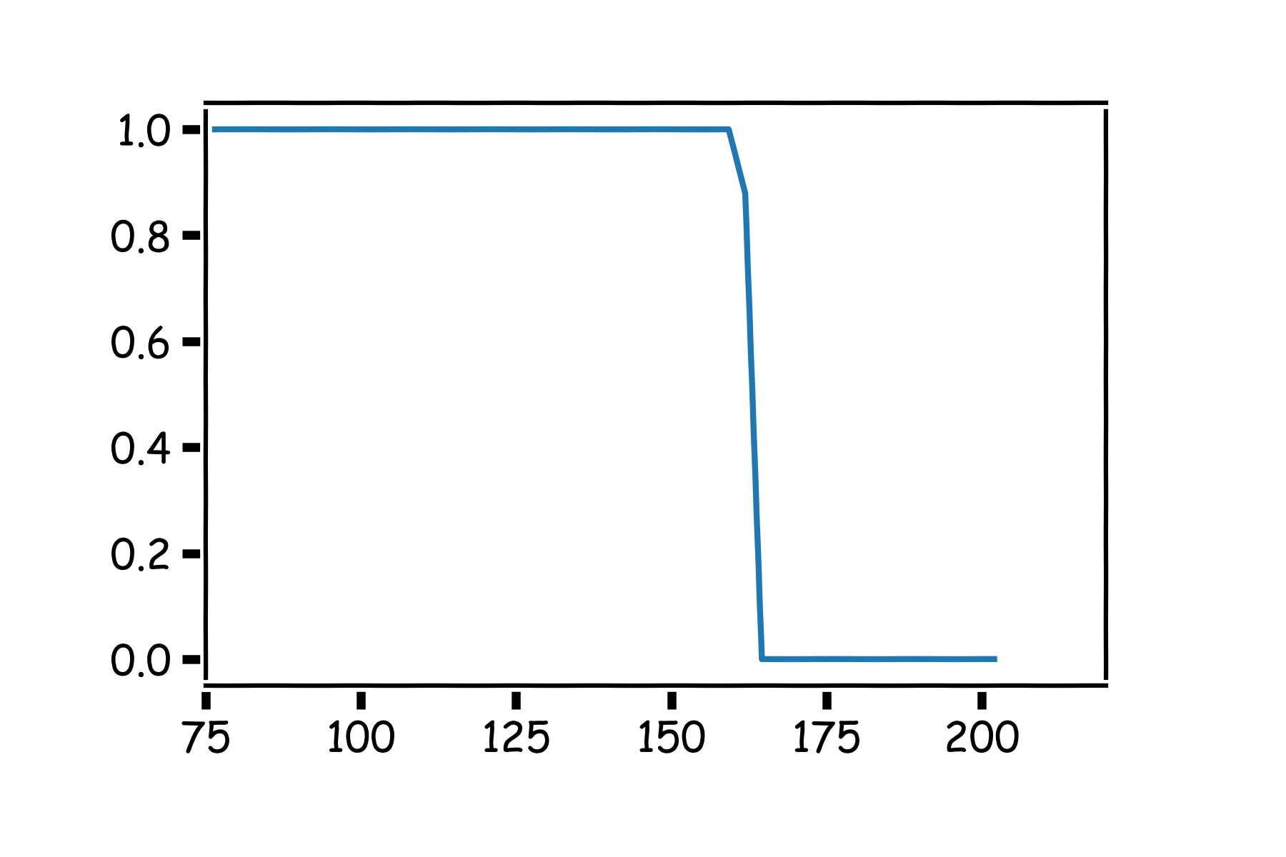
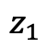
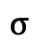

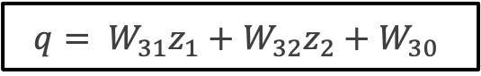
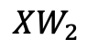
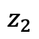

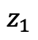
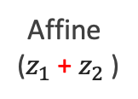
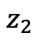
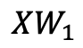
Combining Neurons
$$q= W_{31}z_{1}+{W_{32}z}_{2}+W_{30}$$
$$XW_{1}$$
$$σ$$
$$z_{1}$$
$$z_{1}$$
$$q= z_{1}+z_{2}$$
Affine
($z_{1}$ + $z_{2}$ )
$$X$$
$$z_{2}$$
$$z_{2}$$
Not a probability!
$$XW_{2}$$
$$σ$$

Slide 14

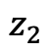
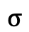
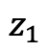

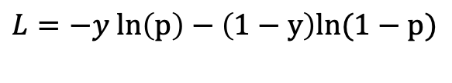
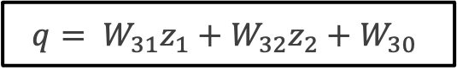
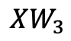

Combining Neurons …
$$q= W_{31}z_{1}+{W_{32}z}_{2}+W_{30}$$
$$z_{1}$$
$$p=\frac{1}{1+e^{−q}}$$
$$XW_{1}$$
$$σ$$
$$z_{1}$$
$$X$$
$$XW_{3}$$
$$σ$$
$$z_{2}$$
$$z_{2}$$
Passing through sigmoid yields probability
$$XW_{2}$$
$$σ$$
$$L=−y ln\left(p\right)−\left(1−y\right)ln(1−p)$$
Need to learn $W_{1}$, $W_{2}$ and $W_{3}$

Slide 15
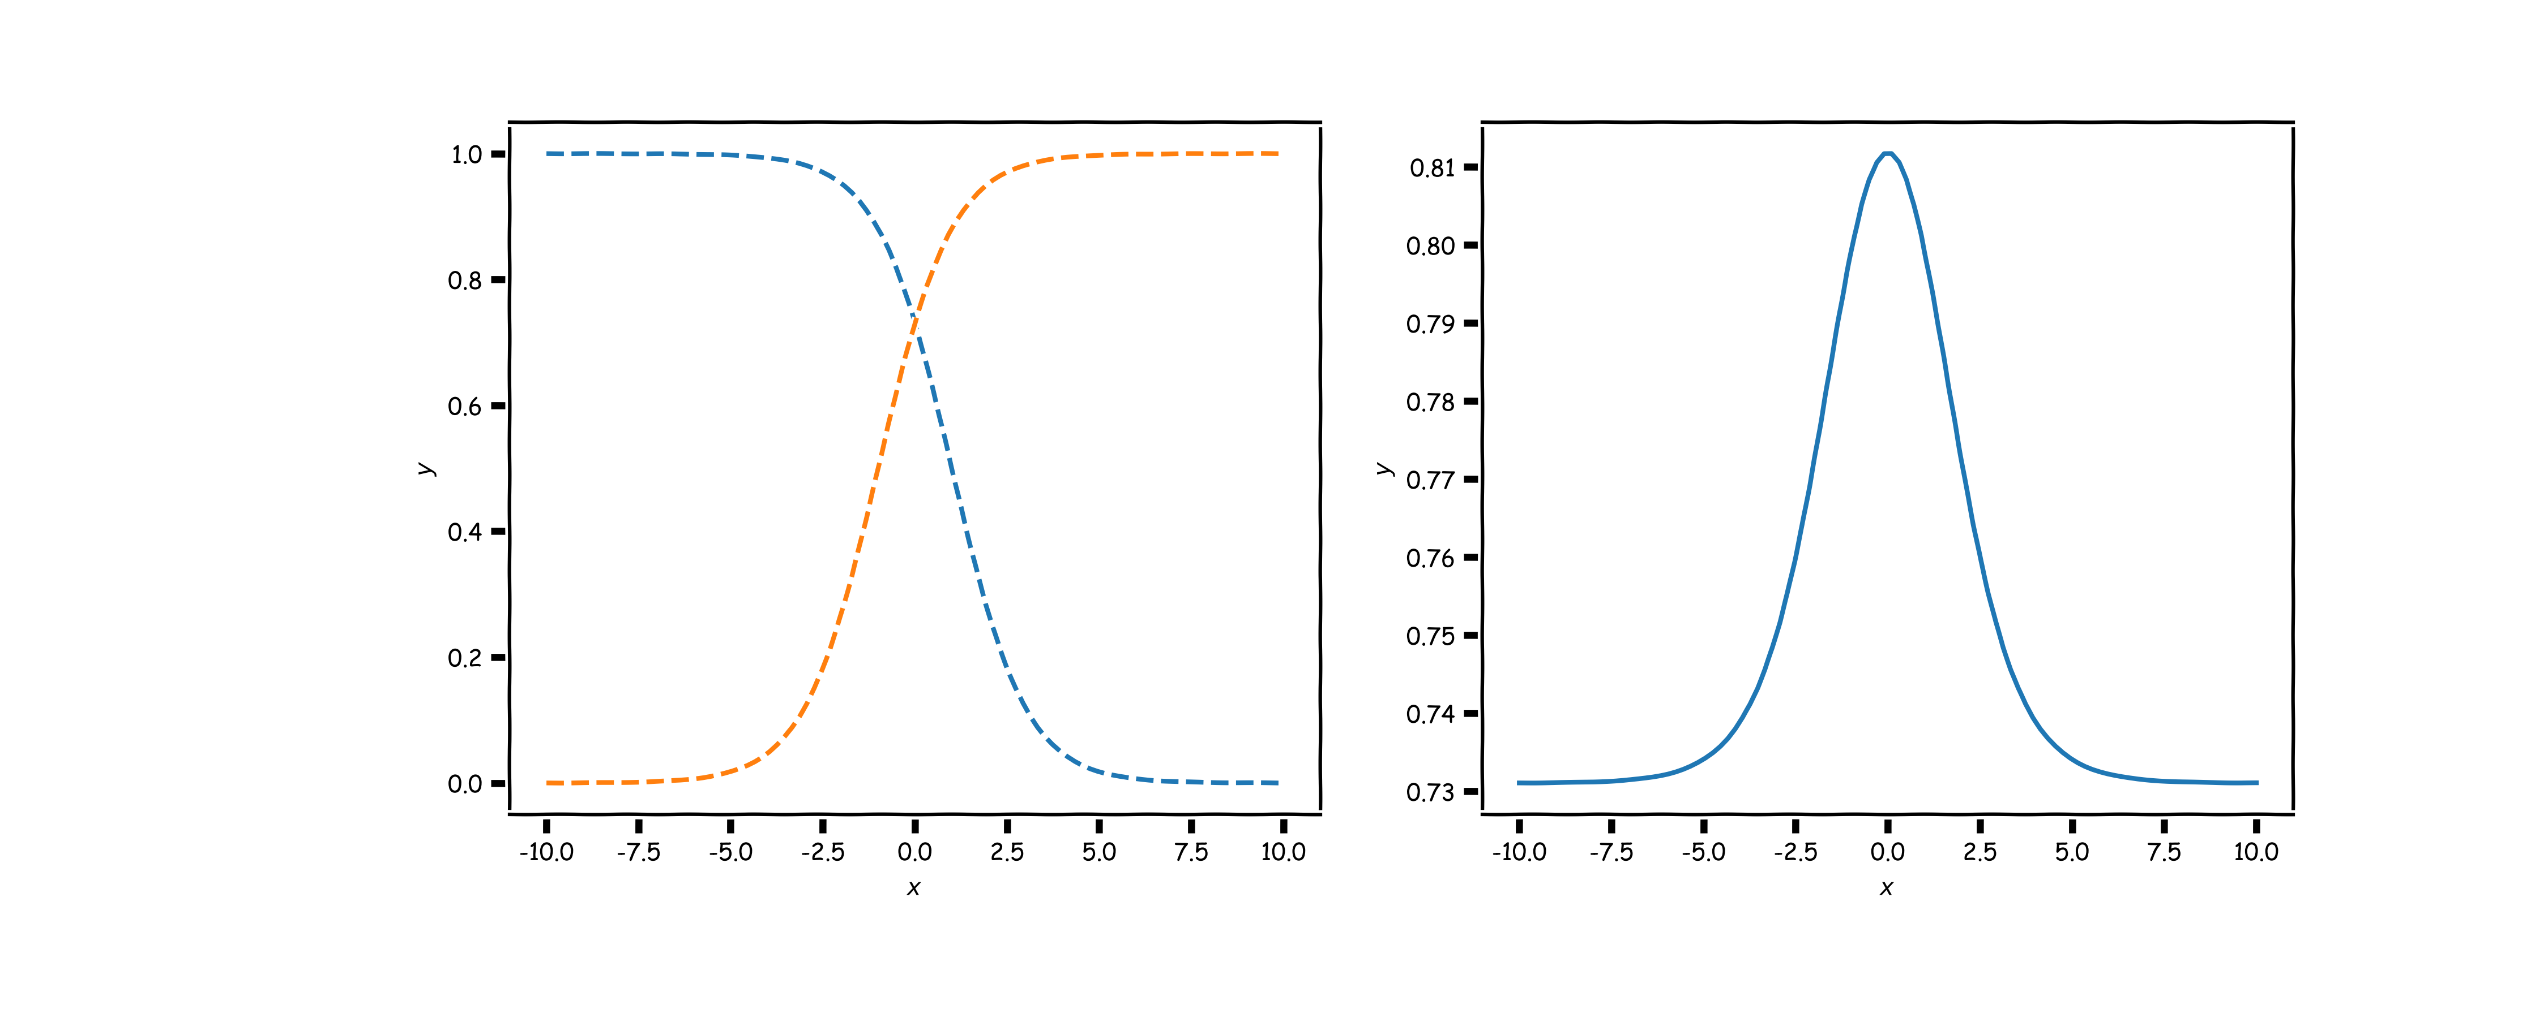
Combining neurons allows us to model interesting functions
X
Y

Slide 16
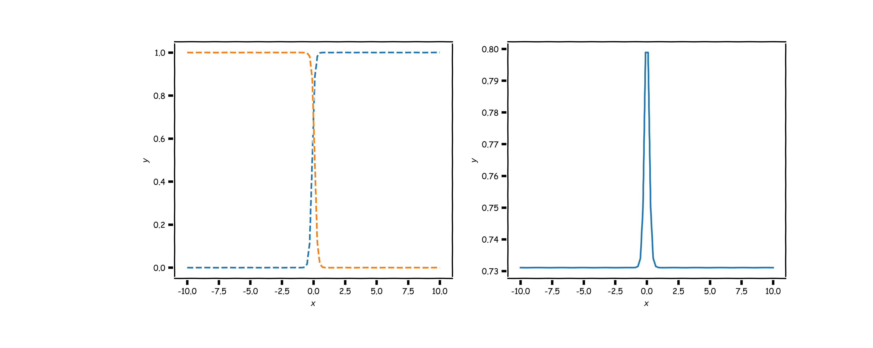
Different weights change the shape and position
X
Y

Slide 17
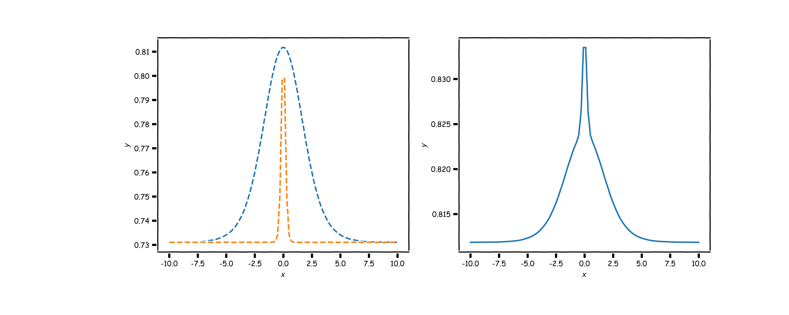
Neural networks can model any reasonable function
X
Y

Slide 18
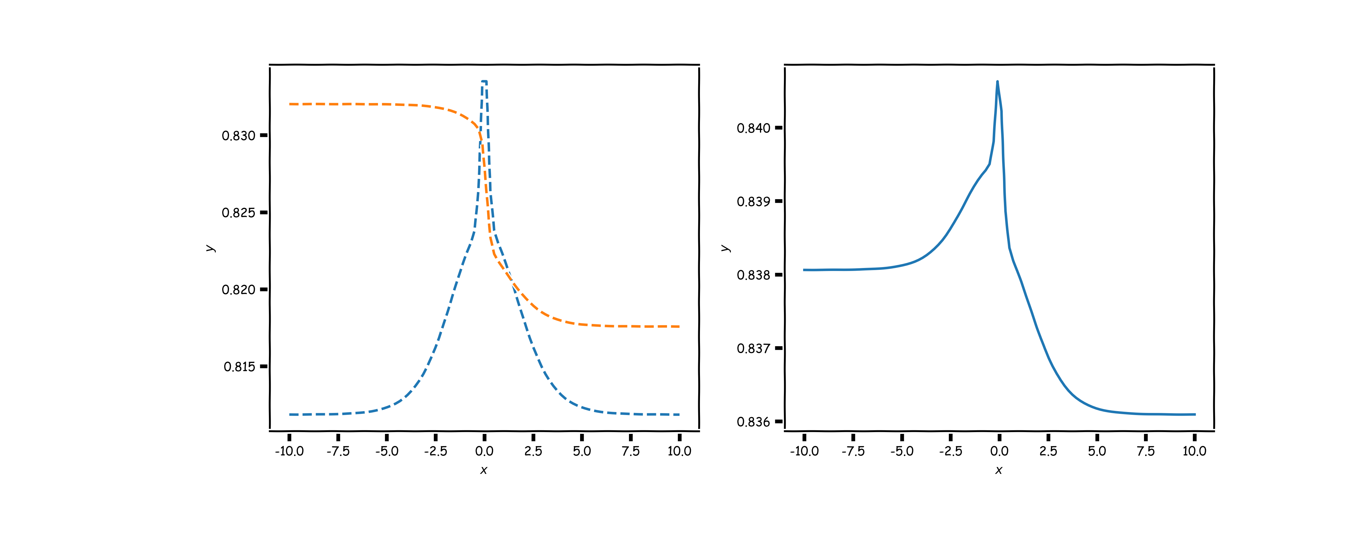
Adding layers allows us to model increasingly complex functions
X
Y

Slide 19
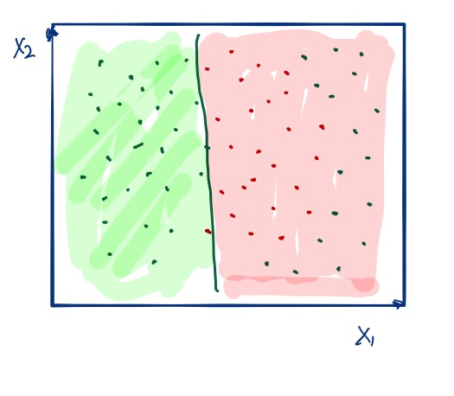
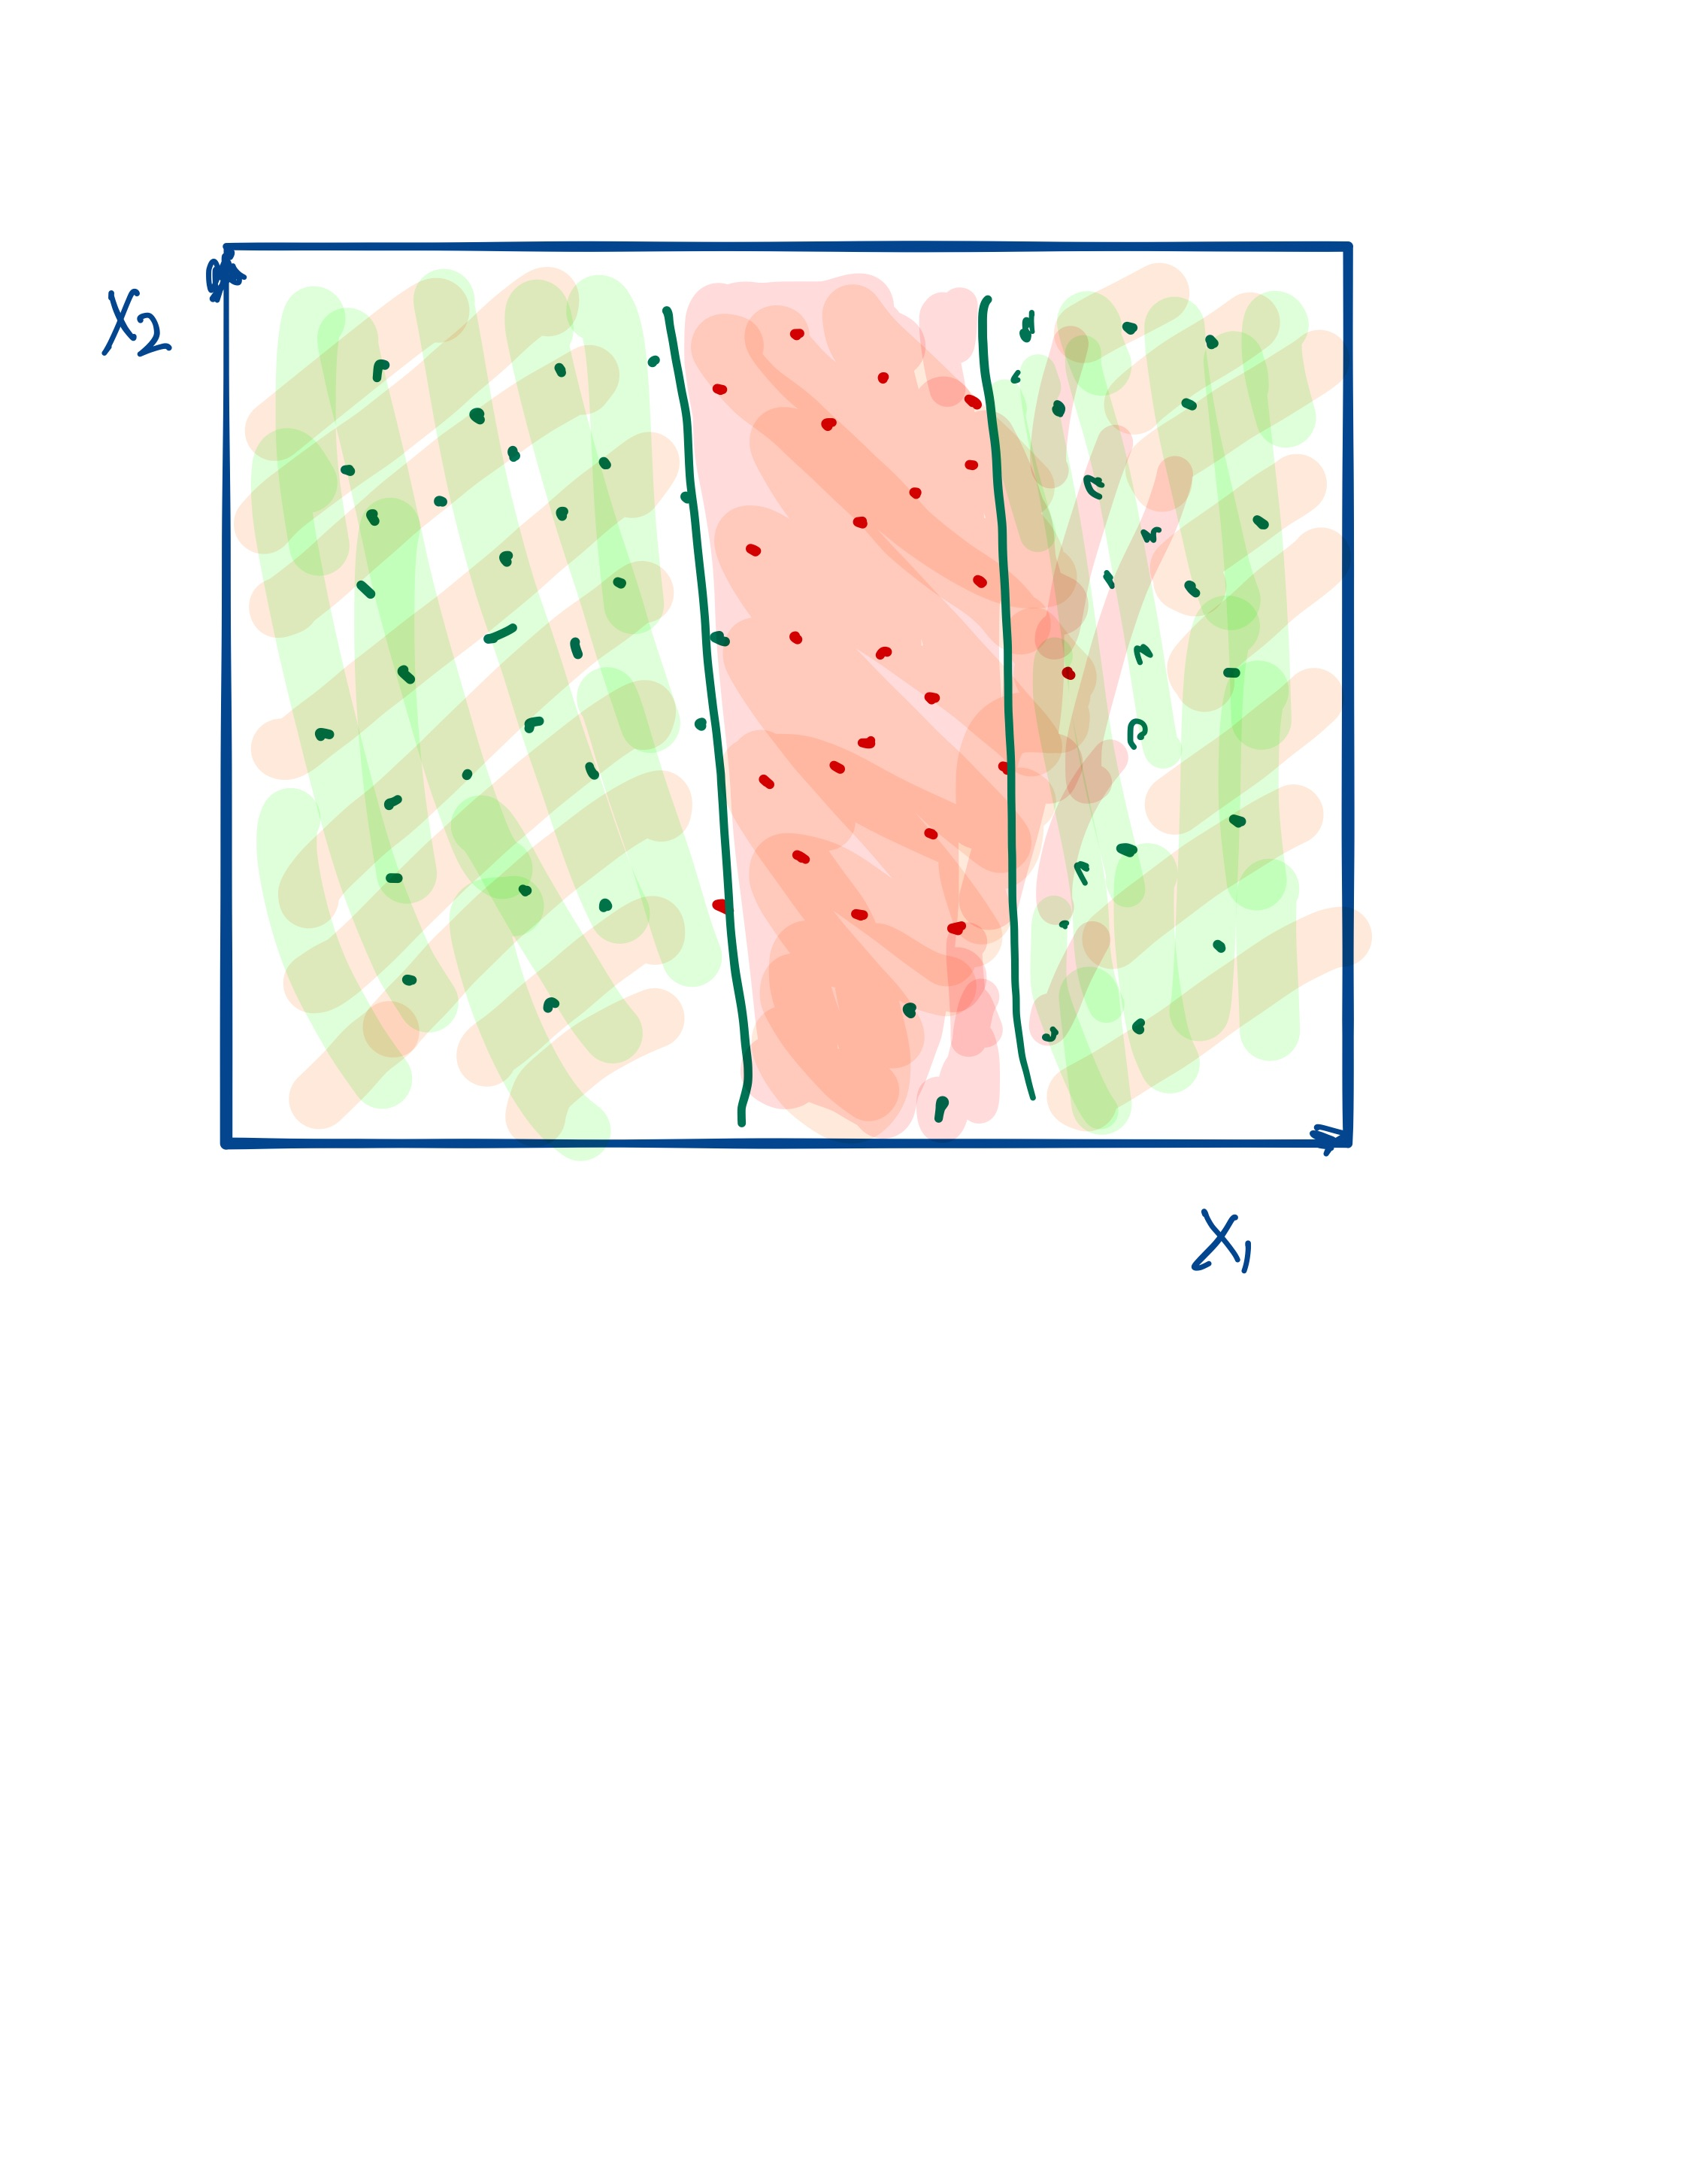
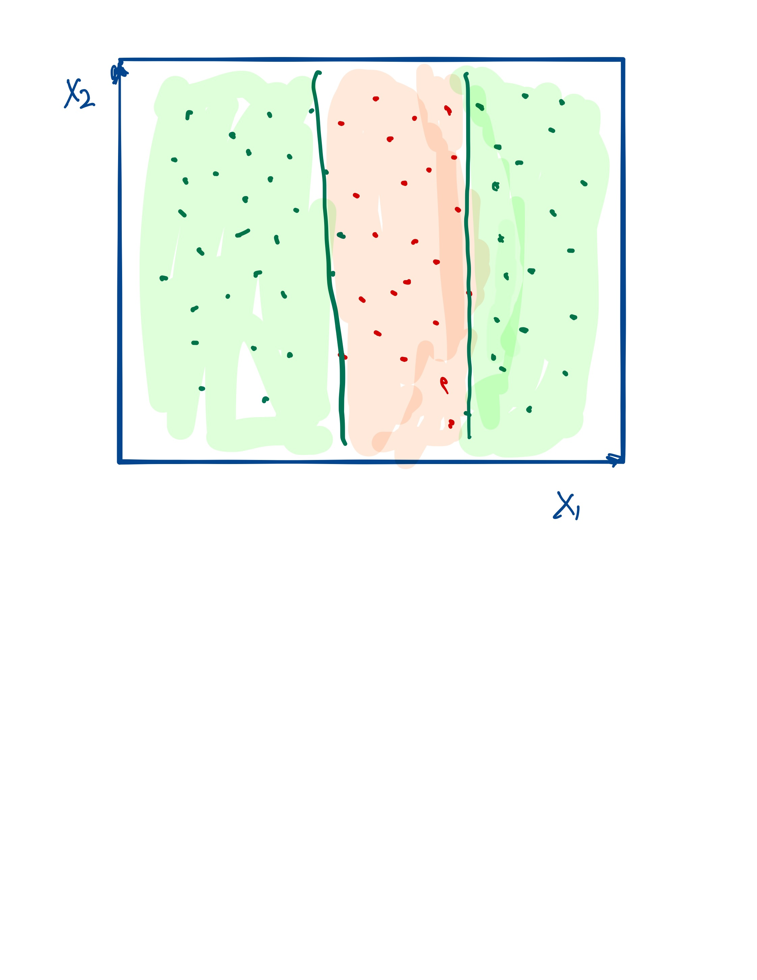
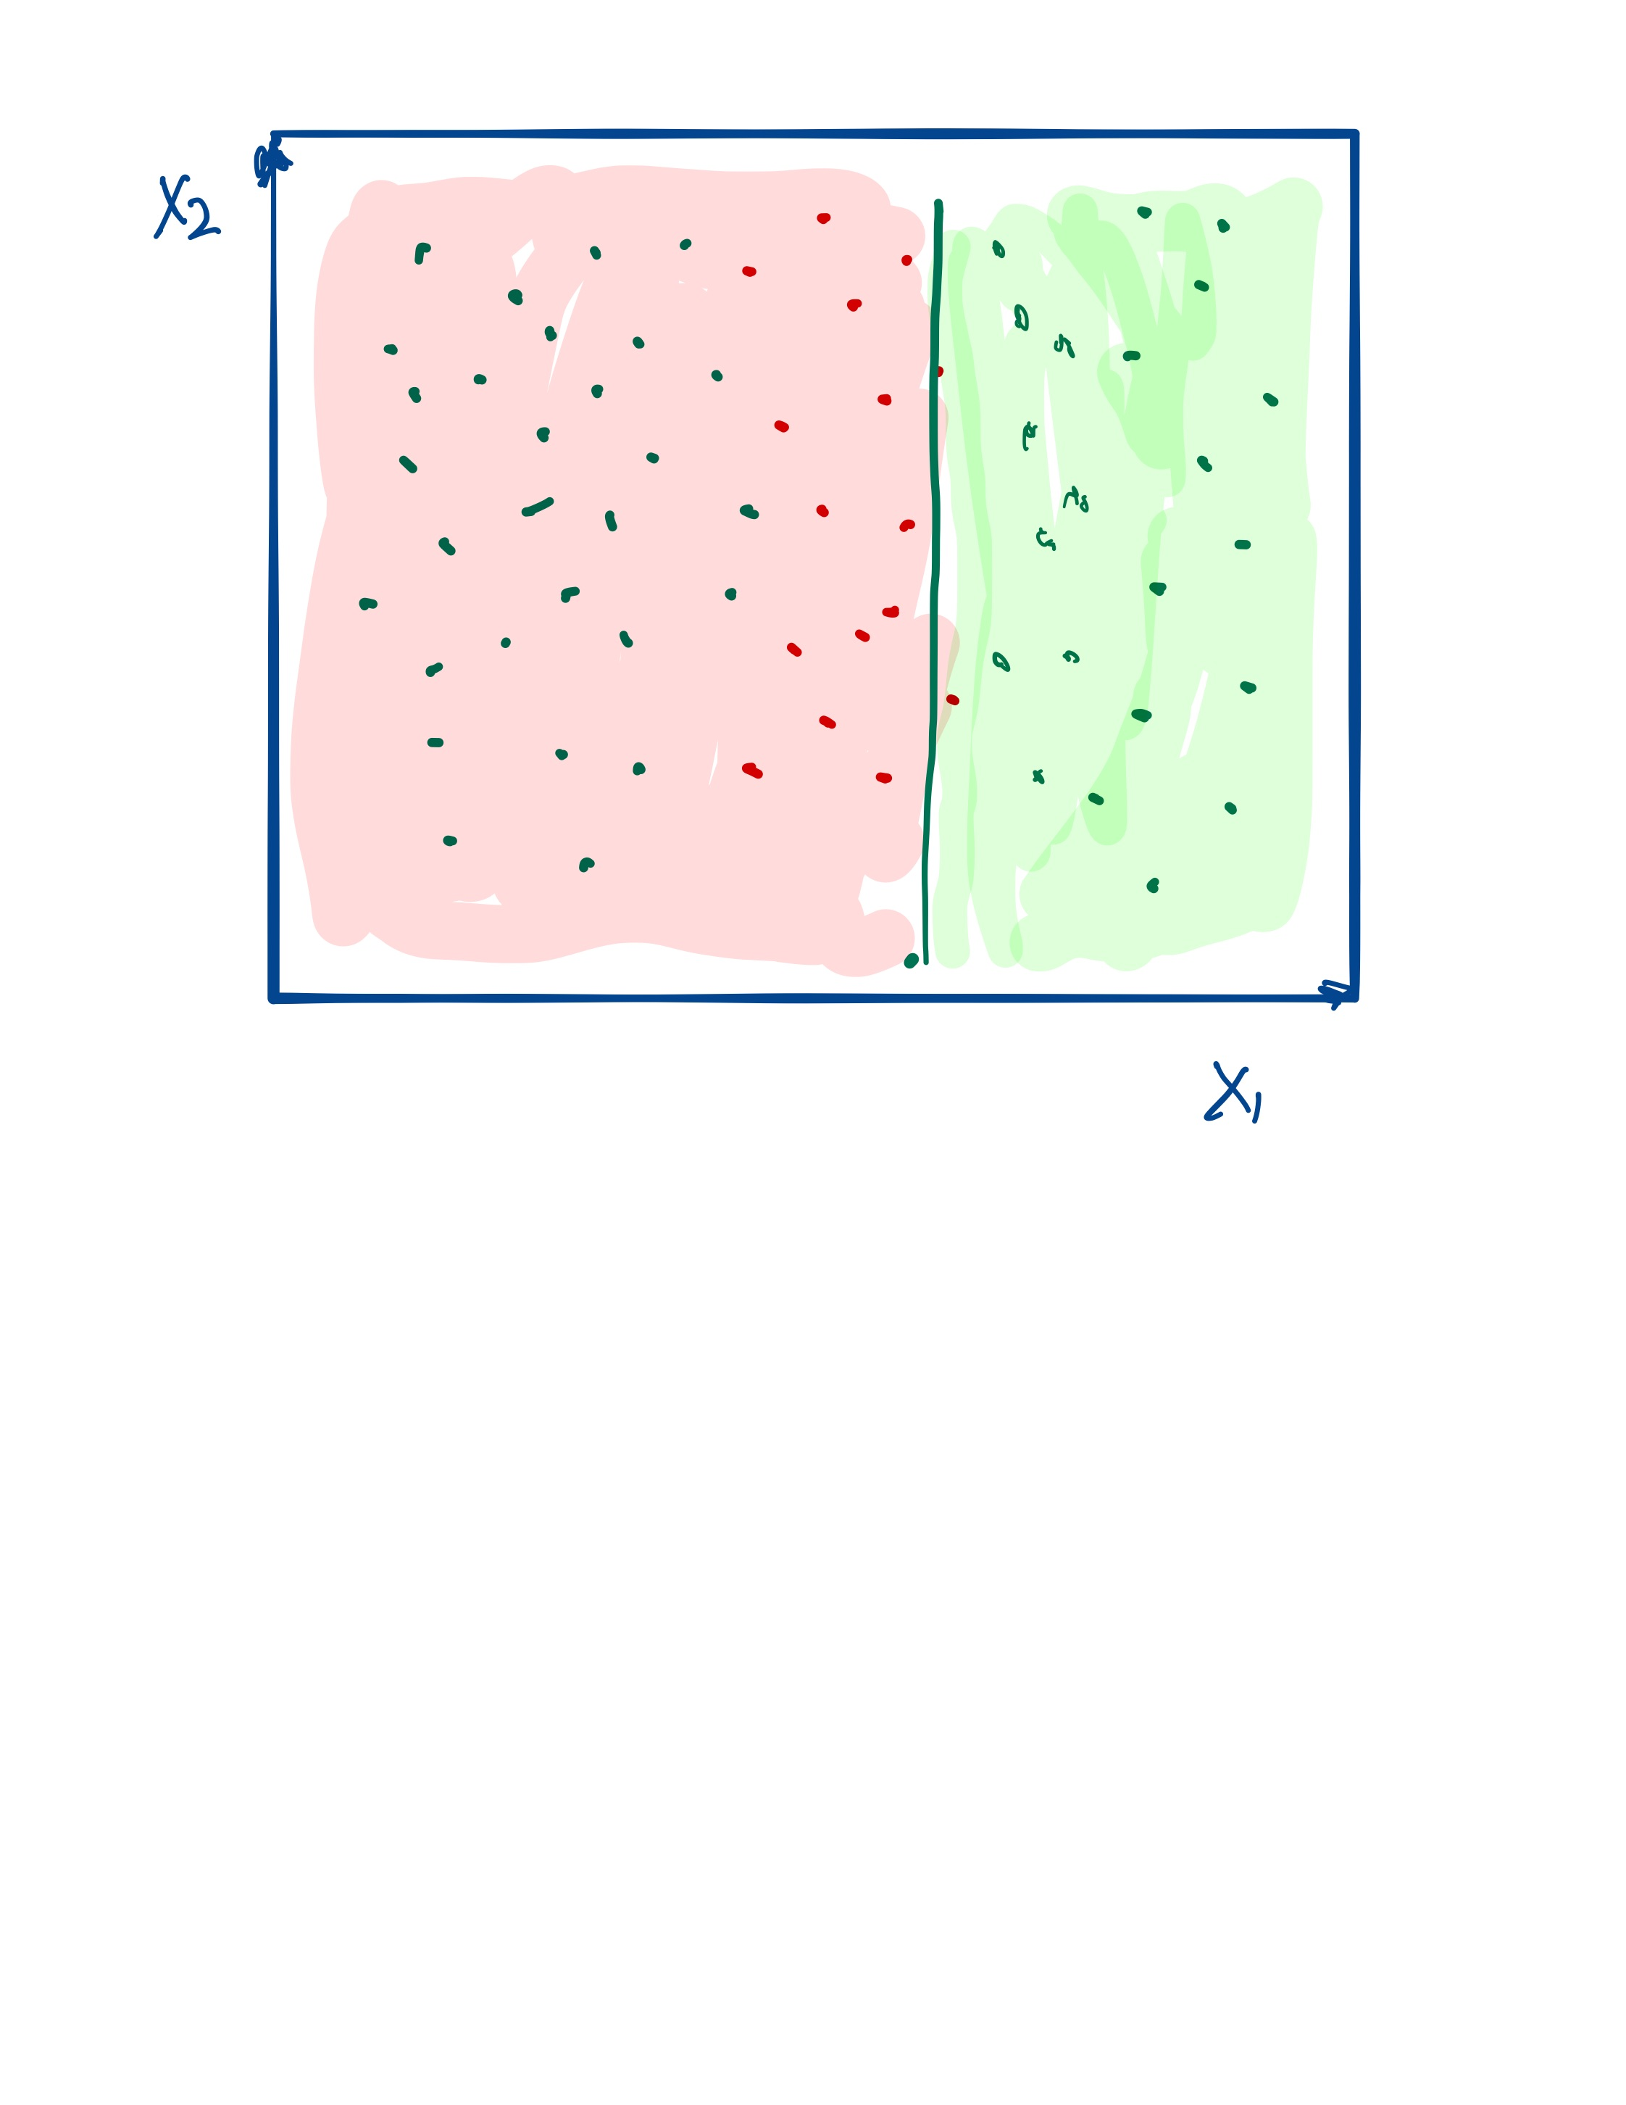
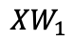
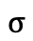
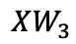
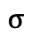
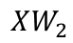
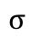
For 2-D input the same idea applies.
$$XW_{1}$$
$$σ$$
$$XW_{3}$$
$$σ$$
$$XW_{2}$$
$$σ$$

Slide 20
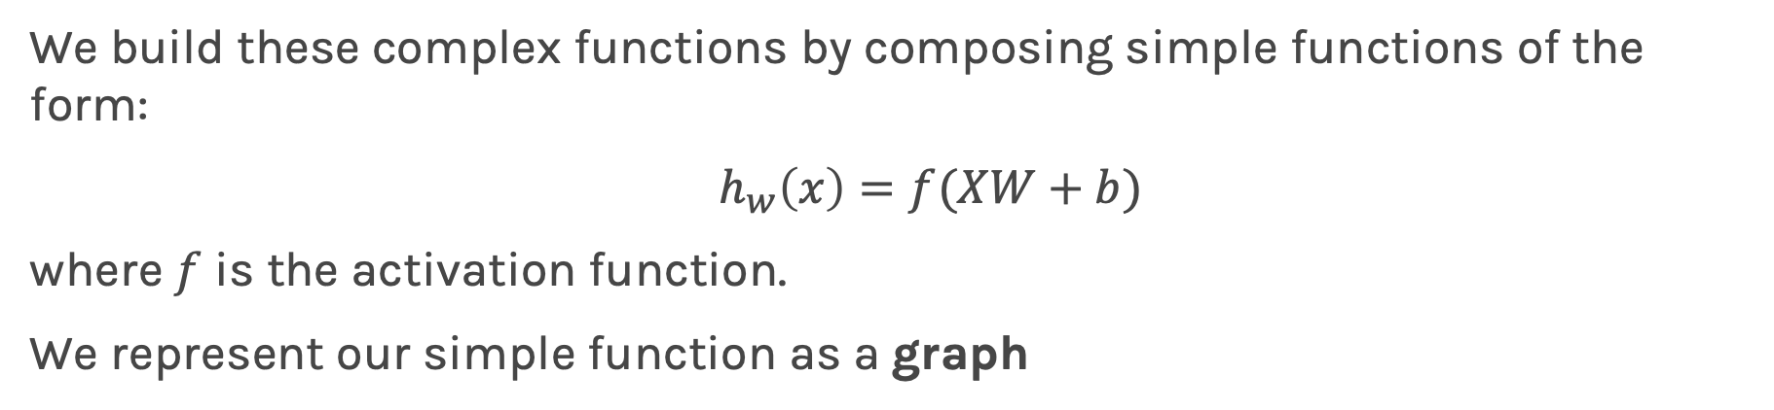

Summary
We build these complex functions by composing simple functions of the form:
$h_{w}\left(x\right)=f(XW+b)$
where $f$ is the activation function.
We represent our simple function as a graph
Each edge in this graph represents multiplication by a different weight, $w_{i}.$

Slide 21










Flow in NN
$$n_{1}$$
$$W_{1,1}$$
$$h_{1}={σ(W}_{1,1}x_{1}+W_{2,1}x_{2}+b_{1})$$
$$x_{1}$$
$$W_{2,1}$$
$$W_{1,2}$$
$$x_{2}$$
$$n_{2}$$
$$W_{2,2}$$
$${h_{2}=σ(W}_{1,2}x_{1}+W_{2,2}x_{2}+b_{2})$$
input
output layer
hidden layer 1

Slide 22
Summary
So far:
A single neuron can be a logistic regression or linear unit. We will soon see other choices of activation function.
A neural network is a combination of logistic regression (or other types) units.
A neural network can approximate non-linear functions either for regression or classification.

Slide 23
Next
Next:
What kind of activations, how many neurons, how many layers, how to construct the output unit and what loss functions are appropriate?
Following lectures on NN:
How do we estimate the weights and biases?
How to regularize Neural Networks?

Slide 24
Next
Next
What kind of activations, how many neurons, how many layers, how to construct the output unit and what loss functions are appropriate?
Following two lectures on NN:
How do we estimate the weights and biases?
How to regularize Neural Networks?

